Slide 1

Machine Learning for Cyber Security
Week 9
Mesut GUVEN, Ph.D.

Slide 2
information
Exams; 55% (Mid 25% + Final 30%), Homeworks; 15%, Project; 30%
In homeworks, you will be expected to examine SCI/E papers (published in last 3 years).
In Final Project, you will implement an AI/ML-based cyber solution.
Textbook:
- Getting Started with Deep Learning: Programming and Methodologies using Python
- Hands-On Machine Learning with Scikit-Learn, Keras, and TensorFlow, 2nd Edition
Code: GitHub
Videos: YouTube

Slide 3
UNIT 9: transfer learning
Learning Outcomes;
- have a better understanding of usage of pre-trained models in cyber,
- Malware detection by using a transfer learning model.

Slide 4
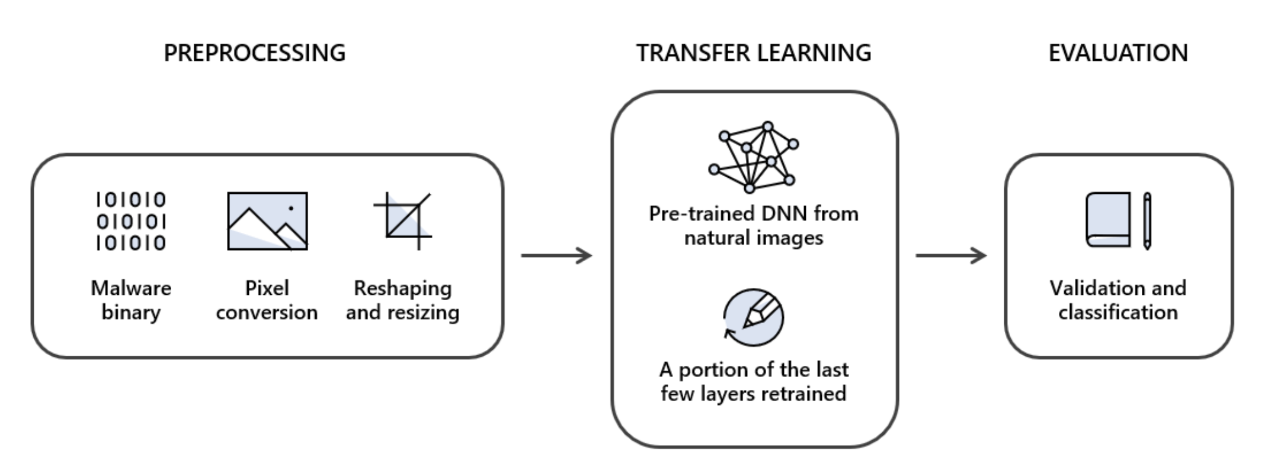
Using Transfer learning for malware detection
The code is available in the Google Colab for this example!

